Slide 1
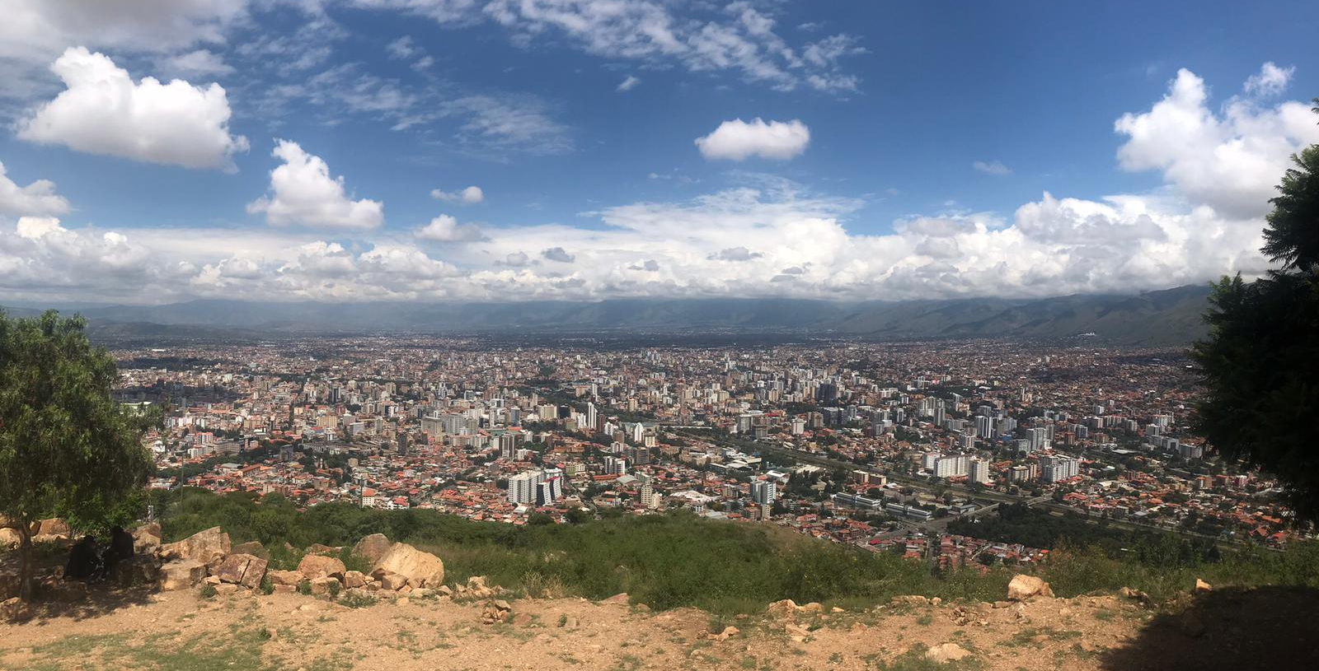
Analyzing neighborhoods in the US
Capstone Project 1 | Coline Zeballos

Slide 2



Problem statement
Predict the number of visitors in each CBG* each day and each hour
What are the most popular brands in a neighborhood?
Are there regional preferences for same brands over others?
At what time do people visit certain CBGs?
Restaurants, shops/stores, companies, mayor of a city could be interested to know which area attracts the most people to take decisions such as:
When and where do we need more/less public transportation?
What type of business to implement in which area?
Where to implement a new restaurant, shop strategically?
When to organize an event?
*CBG = census block group

Slide 3

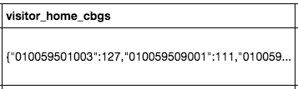
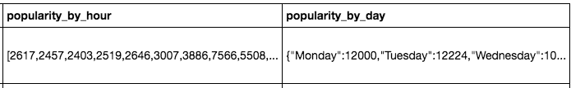

The data
Data source:
SafeGraph’s Open Census Data based on the US Census Bureau data
/!\ Problem /!\ A lot of work to get the data ready for analysis
perform sanity checks
split columns
remove NA rows
create additional columns (ratios, top 10 brands)
convert new columns to right type

Slide 4
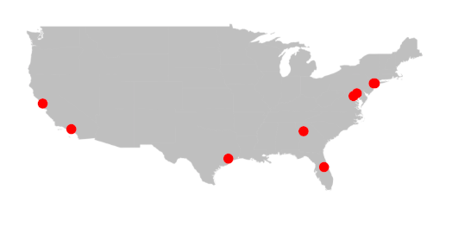
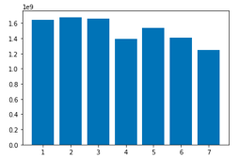
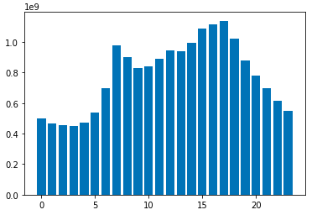
Initial findings
Most visits: Tuesday
Least visits: Sunday
Top 10 most visited CBGs
Most visits:
5pm
Least visits:
3am

Slide 5
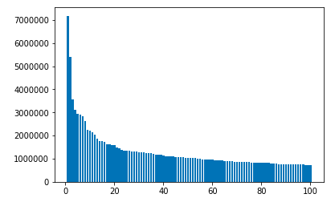
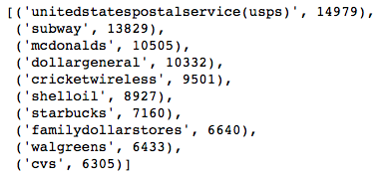
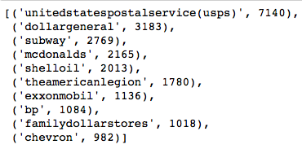
Initial findings
Top 100 most visited CBGs
Top 10 most visited brands during the week
85% of CBGs have a higher amount of visitors during the week (Monday toThursday) than during the weekend (Friday to Sunday)
Top 10 most visited brands during the weekend

Slide 6
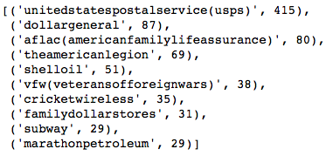
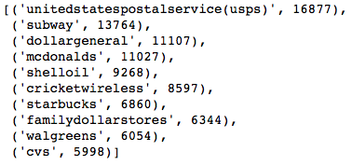

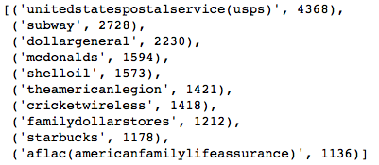
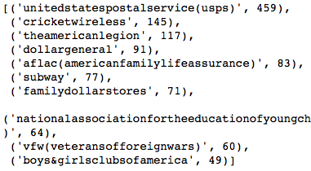

Initial findings
AM
PM
Top 10 most visited brands during early morning
Top 10 most visited brands during afternoon
AM
PM
Top 10 most visited brands during morning
Top 10 most visited brands during evening

